Slide 1
Advance Blackbox testing
Naseem us sehar

Slide 2
A/B testing
In A/B testing, two versions of the same webpage are put under test with an equal amount of webpage traffic. The version which gets a maximum number of conversion is the ultimate winner. This new version definitely increases the conversion rate.
A/B testing is also known as Split Testing.

Slide 3
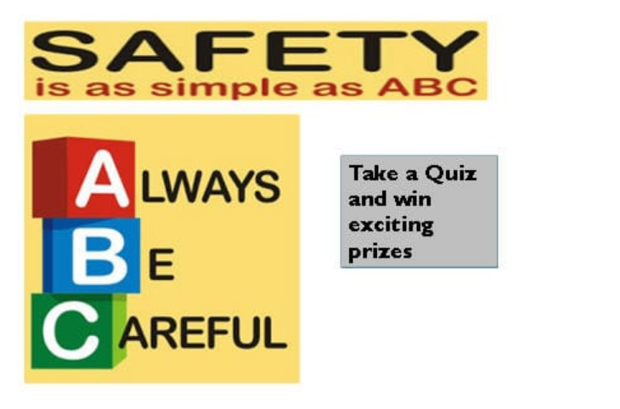
A/B Split Testing Example:
This image consists of a grey button saying “Take a Quiz and win exciting prizes”.This original webpage is considered as ‘A Version’. Now ‘B version’ is designed with a variation in color of the button from Grey to Red.

Slide 4
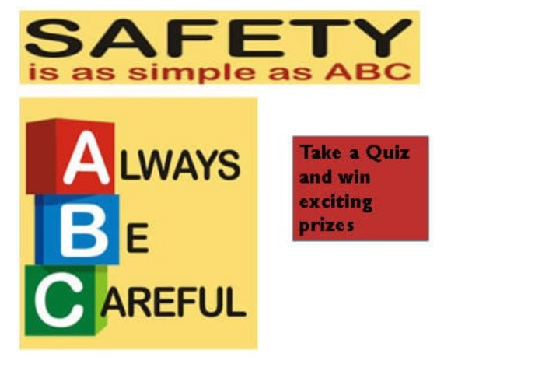
The other version of same page
Which version between the two pages will generate more results/traffic?

Slide 5
Example (continued)
Here in the above example, a button saying “Take a Quiz and win exciting prizes” in Red color attracted more visitors to hit the button and take a quiz than the older Grey button.
Thus, the webpage’s ultimate goal to increase more revenue was achieved.

Slide 6
Pros of A/B testing
Easy and simple method to set up experiments for webpage optimization.
Reliable and accurate results can be easily determined even with small webpage traffic.
Tests can be performed very quickly and statistical data can be analyzed to reach the ultimate goal.
Not much dependent on any form of technology.
More apt for changes in layout, content, design of any webpage.

Slide 7
Cons of A/B testing
Only a few or say a limited number of changes can be done to a webpage at a time.
It is not possible to determine the impact of different variables present on a webpage on each other.

Slide 8
Usability Testing
We test a software product, website, or service to measure the quality of the deliverables. This test consists of both functional and non-functional testing. Usability testing is one of the many non-functional testing types.
It is a non-functional type of software testing. It is broadly divided into understandability, learnability, operability, attractiveness, and compliance. Usability testing is to determine the extent to which we understand the software product, easy to learn, easy to operate, and attractive to the users under specified conditions and requirements.
This type of testing is usually executed by real-life users and not the development team.

Slide 9
Usability testing is mainly divided into three categories.
Explorative: We usually consider this category in the early stages of the software testing process. The earlier usability testing is executed in the testing process, the minimum is the risk in the product. The design of the product and concepts related to the product or service is usually considered for usability testing in this stage.
Assessment: This category describes the assessment of the end-to-end execution of the test and also analyze the effectiveness of the product and user satisfaction.
Comparative: In this category, two or more products of similar technology are compared at different attributes as the design of the product, advantages, disadvantages of the product or services, and which helps in selecting the product that provides a better user experience.

Slide 10
Usability Testing Methods
Hallway Testing : In this method, few random people are given the website or product to test rather than trained professionals.
Remote Usability Testing: remote usability testing takes place by people who are located at remote locations, i.e. who are located in several states or sometimes in several countries for testing purposes. This type of testing is done remotely and issues can be reported if found. Feedback can be recorded and can be submitted by random people and not a technology expert. Sometimes remote testing is executed using video conferencing. This type of usability testing adds less cost value as compared to other types of testing.
Expert Review: This testing is reliable because of the experience possessed by the expert. Expensive and less time consuming

Slide 11
Usability Testing Methods
Paper Prototype Testing: Discussing the flow and drawing them on paper and considering all the possible inputs and scenarios and conditions is the objective of this type of testing. This is one of the primary types of testing which is mostly observed across all the projects to eliminate primary issues. By performing paper prototype testing, one can have more clarity on the execution process.
The paper prototype testing is usually done within the project team. Hence it is considered in the earlier stages of the testing process. This is relatively a cheaper method of usability testing but is not the most effective way of testing as it is more time-consuming at times and there is a higher possibility that even after testing we may lose a few issues.
Automated Usability Testing: using tools and writing scripts

Slide 12
Advantages of Usability Testing:
By executing a usability test, we can improve on the flaws of the product, if found any, and rectify them before the launch of the product. Executing tests will thereby help in boosting product quality.
Many times internal discussions are headed towards debates that can be resolved after performing usability testing, which helps in understanding the user experience better.
Sometimes it is observed that the development team fails to detect a few minor defects which can be found by executing usability testing.
As the feedback is directly from the user side, it becomes beneficial for the business to improve the product according to the target audience.

Slide 13
Disadvantages of Usability Testing:
Financial constraint is one of the major disadvantages as one needs to recruit and manage the resources for usability testing.
Can be dependent on culture and traditions.

Slide 14
Random testing from book section 9.7

Slide 15
Thank you!!

